Slide 1
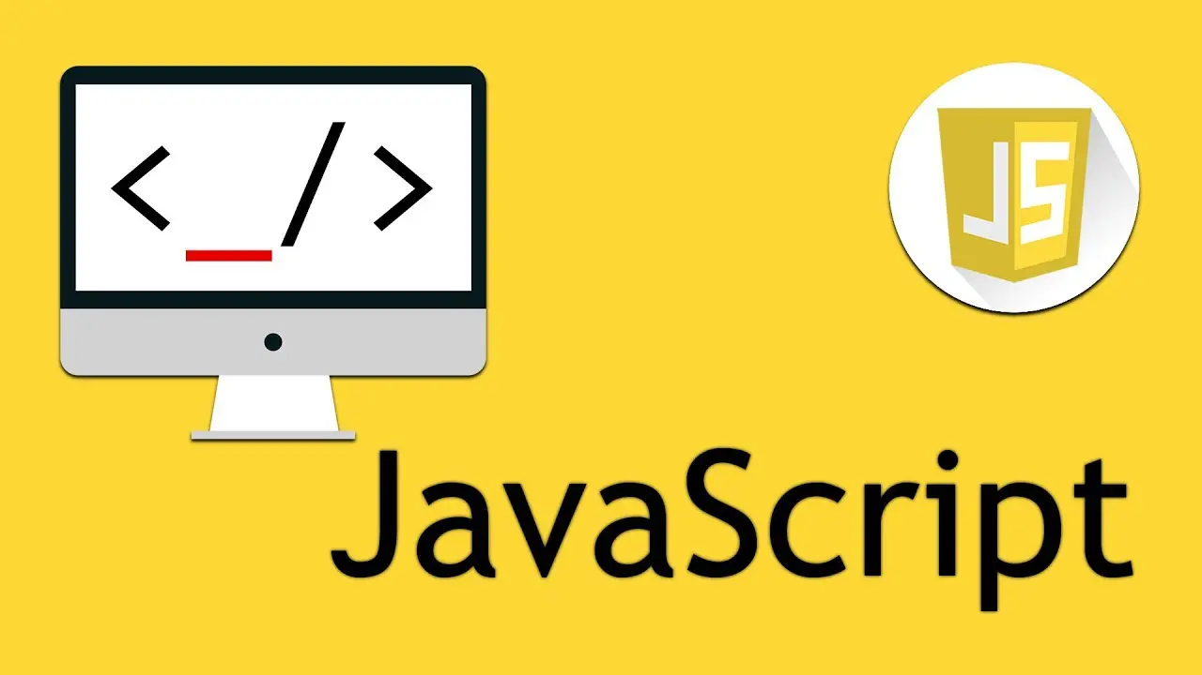

Slide 2
What is JavaScript
JavaScript is a high level programming language which is used to create interactive web pages.
It is the only language understood by browser.
JavaScript is a scripting language.
It is the language you can use at browser side as well as server side.
It is the most commonly and popular language used right now.
A lot of framework and libraries are based on Javascript. It can be used for both frontend and backend.
Frontend – React.Js, Angular.Js, Next.Js
Backend – Node.Js, Express.Js

Slide 3
Why We using the js?
We use JavaScript (JS) because it makes web pages interactive.
Without JS:
A website is just static—it only shows text and images but doesn’t respond when you click buttons or type something.
With JS:
You can create dynamic content (like pop-ups, forms, and animations).
It lets users interact (click, scroll, type, play music, etc.).
It works in the browser without needing extra software.
Basically, JS makes websites alive instead of just looking like a book.

Slide 4
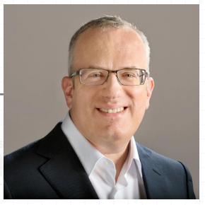
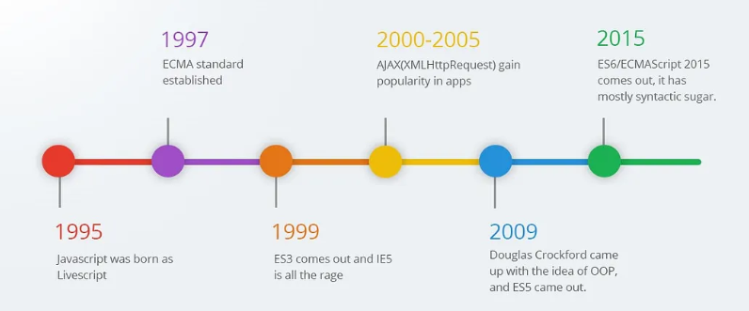
History of JavaScript (JS)
1995 – Brendan Eich created JavaScript in just 10 days while working at Netscape.

Slide 5
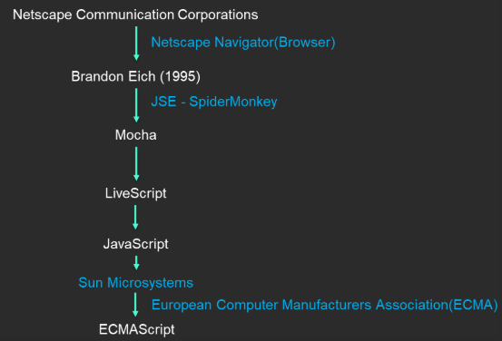
History of JavaScript (JS)

Slide 6
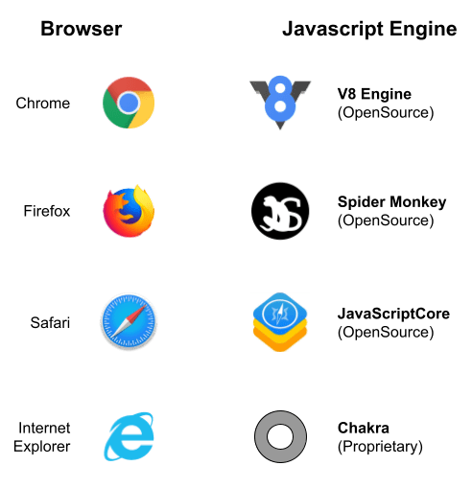
JS Engines of Different Browser

Slide 7
Characteristics of JavaScript
Client-Side Scripting Language
Dynamically Typed Language
Weakly Typed Language
Interpreted Language
Synchronous in Nature (Single-Threaded)

Slide 8
Characteristics of JavaScript
Client-Side Scripting Language:
Runs inside the browser (Chrome).
No need for a server to process every action.
Example: Clicking a button changes text instantly.
2. Dynamically Typed Language:
No need to define variable types (number, string, etc.).
JS automatically detects the type at runtime.
3. Weakly Typed Language:
Allows operations between different data types.
Can cause unexpected behavior.
Example: (String + Number = String), (String - Number = Number)
4. Interpreted Language:
Executes line by line in the browser (no need to compile).
Easier to debug but slightly slower than compiled languages.

Slide 9
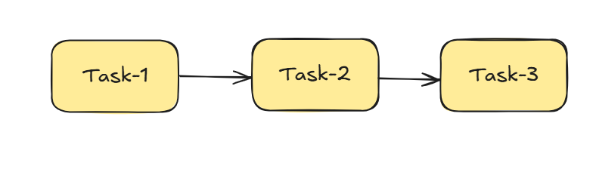
Characteristics of JavaScript
5. Synchronous in Nature (Single-Threded):
Executes one task at a time in order.
Can cause delays if one task takes too long.
Example:
console.log("First");
alert("Pause here...");
console.log("Second"); // Runs only after alert is closed
But JS also supports Asynchronous tasks (like setTimeout & fetch) to handle multiple things smoothly!

Slide 10
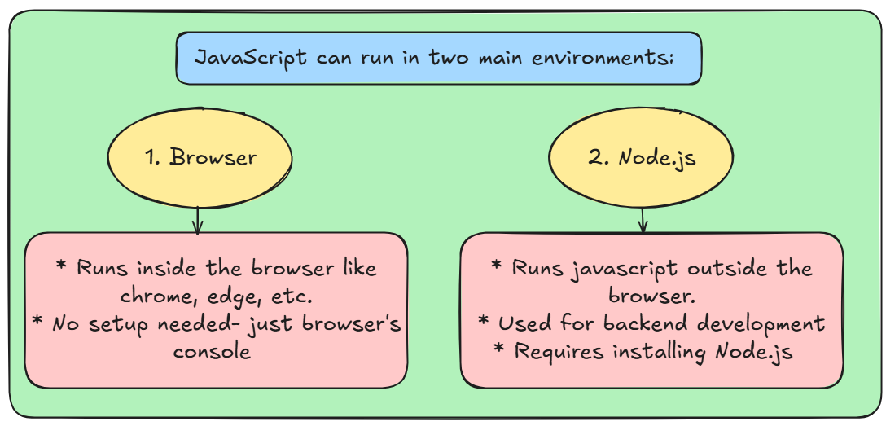
Ways to Run JavaScript Code (Environment Setup)

Slide 11
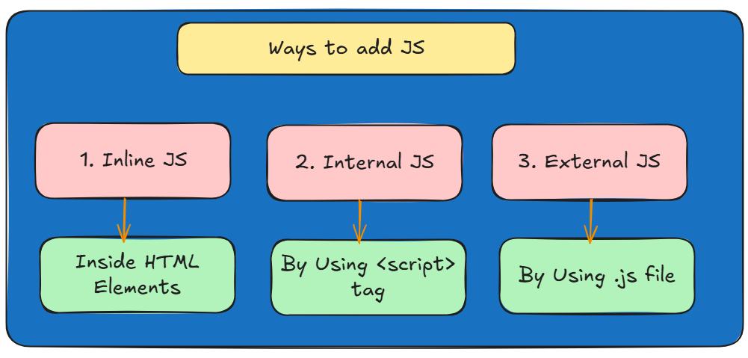
Ways to Add JavaScript to a Webpage

Slide 12
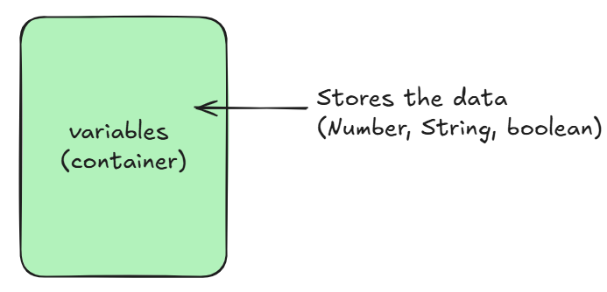
Variables in Javascript
Q. What is a Variable in JavaScript?
A variable is like a container that stores data.
It holds values that can be used and changed in a program.
Types of Variables in JavaScript:
var
let
const

Slide 13
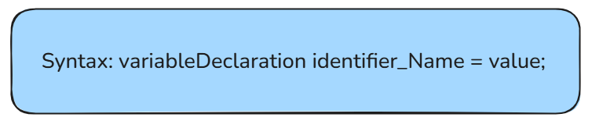
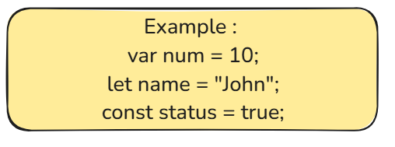
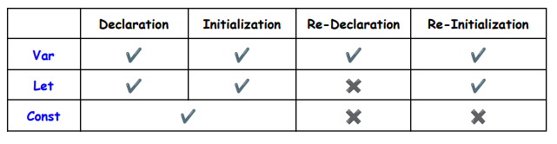
How to declare the variable

Slide 14
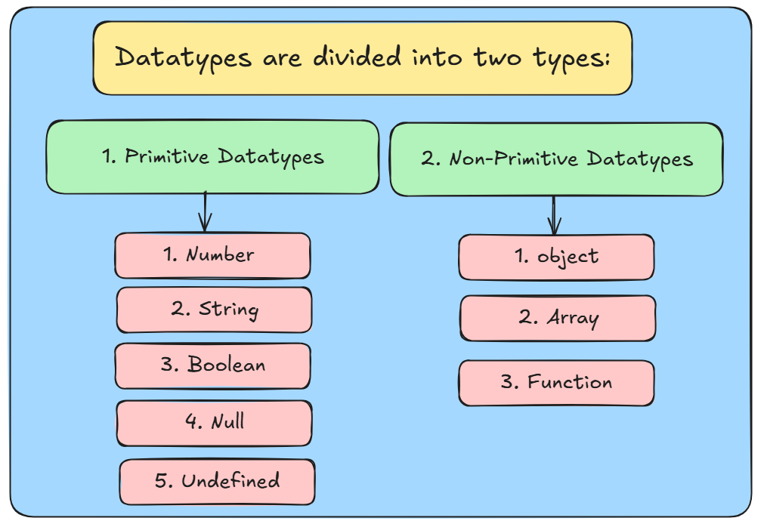
Datatypes in javascript

Slide 15
Primitive Datatypes
Number: It is the values which may be integers or decimal. (Ex: 10, 5.5, 3,27, etc)
String: It is the combination of characters. And it is enclosed between Single-quotes (‘’), Double-quotes (“”). (Ex: “Hello”, “123”, etc.)
Boolean: It represents true or false values. True means (one-1) and false means (Zero-0). (Ex: true or false)
Null: Means nothing or empty value but not zero (0).
Undefined: A variable that exists but has no value assigned yet.

Slide 16
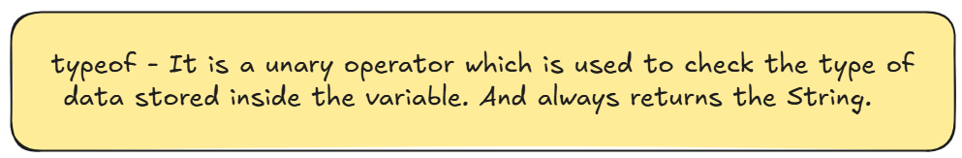
Non-primitive Datatypes
Object: A collection of data which is stored in the form of key-value pairs.
Array: A collection of data that stores multiple type of data.
Function: A reusable block of code designed to perform specific task.

Slide 17
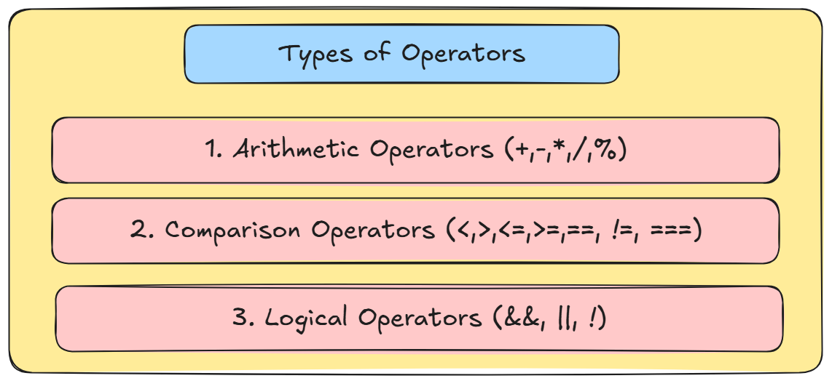
Operators in javascript
Operators are predefined symbols which is used to perform some specific tasks.

Slide 18
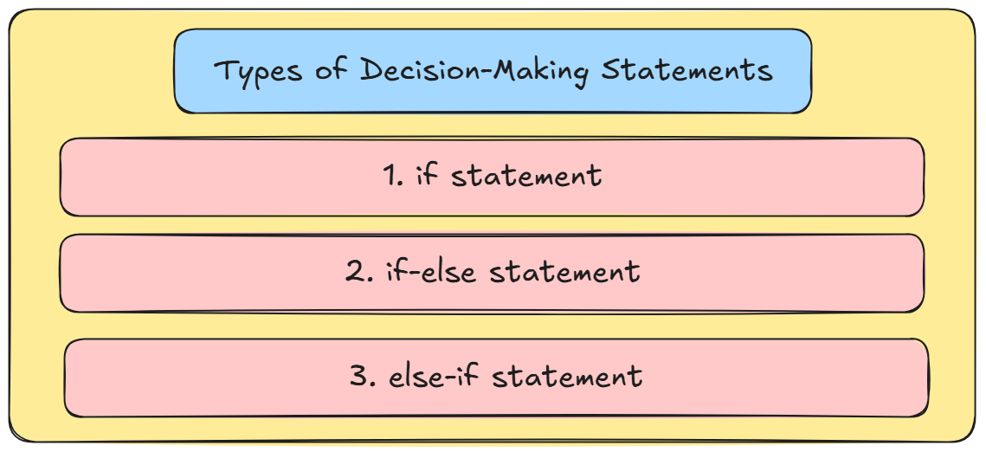
Decision-statements in js
A decision-making statement in JavaScript helps the program decide what to do based on conditions.
It checks if something is true or false and then runs specific code.

Slide 19
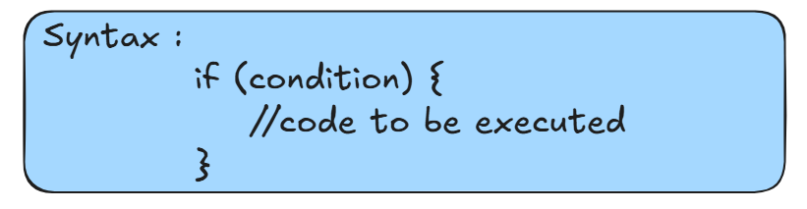
If-statement
If-statement: It will runs when the condition is true only.

Slide 20
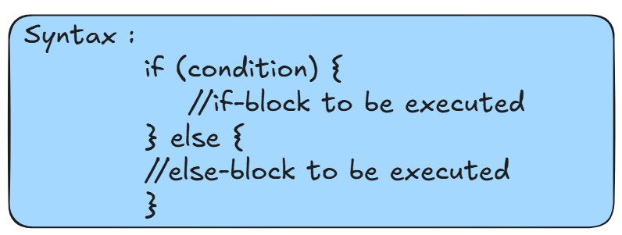
If-else statement
If-else statement: It will runs different true or false. If condition is satisfied then it will execute the if block or condition is false then it will execute the else block respectively.

Slide 21
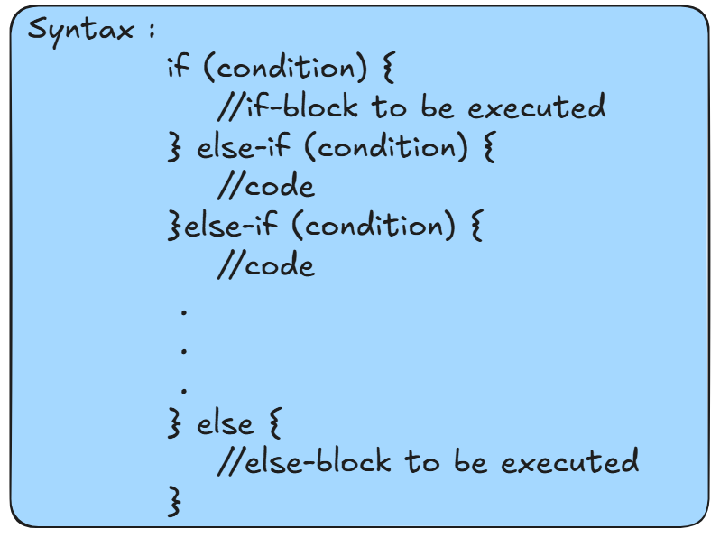
Else-if ladder statement
Else-if ladder: It will checks the multiple conditions.

Slide 22
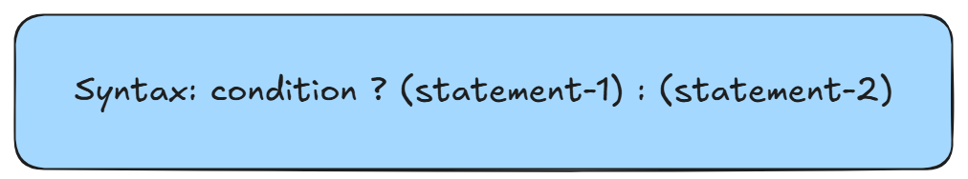
Conditional / Ternary operator
Ternary Operator: The ternary operator in JavaScript is a shorthand way of writing an if-else statement.
It is also called the conditional operator and uses the ? : syntax.
If the condition is true -> statement-1 will be executed
If the condition is false -> statement-2 will be executed

